Slide 1
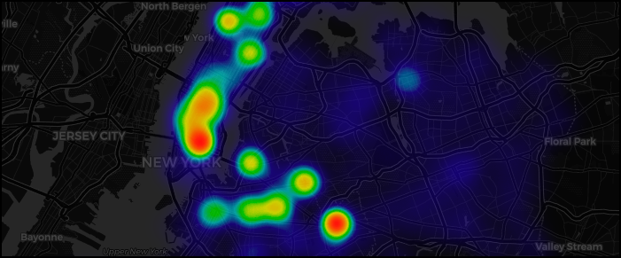
Finding Clusters of Complaints
Analysis of the NYPD Complaints Dataset
Nicholas Occhipinti

Slide 2
Use Case
Crime Analyst in NYC working on a project to identify hotspots of complaints
Results can aid NYPD leadership to make better decisions and develop actionable items to help reduce crime
Where to increase police presence
Better communication between NYPD and communities about emerging crime patterns
Identifying where to allocate funds towards technology such as adding more security cameras
An additional use case of this project is studying how crime has changed during the COVID-19 pandemic

Slide 3
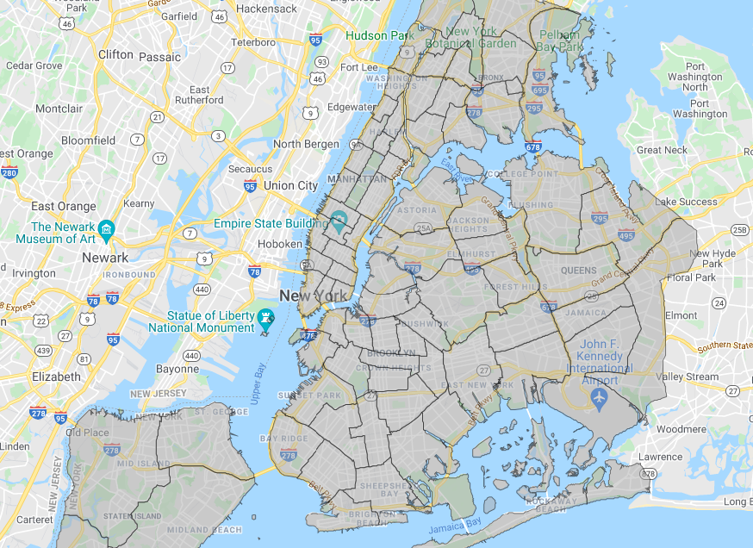
Dataset
Data from NYC Open Data
NYPD Complaint Data
Over 7 million records with 35 features
Information about the complaint, precinct, offense and spatial location
Both a historical and year to date dataset was used
NYPD Precinct Spatial Data
GeoJSON and Shapefile format
Used to display in the map and to get the area each precinct patrols
NYC Borough Boundaries Spatial Data
Shapefile format
Used to assign each location with a borough

Slide 4
Preprocessing
Data filtered to study felonies from 2019 to March 2021 only involving NYPD
Drop unused fields and renamed fields to give them more meaning
Dates chosen to reflect pandemic periods
2019 (pre-pandemic), 2020 (pandemic) and 2021 (returning to normal).
Fill missing data
Determine what to put in place of missing values, store as Unknown as a last resort
Using borough and precincts spatial data to add properties
Cleaned dataset reduced data to 270,221 records and 17 features

Slide 5
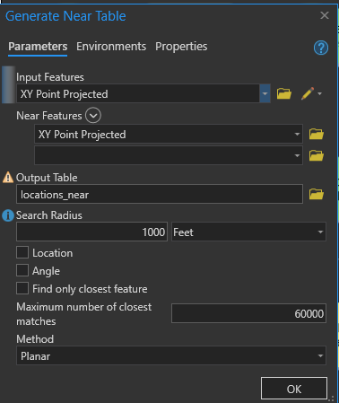
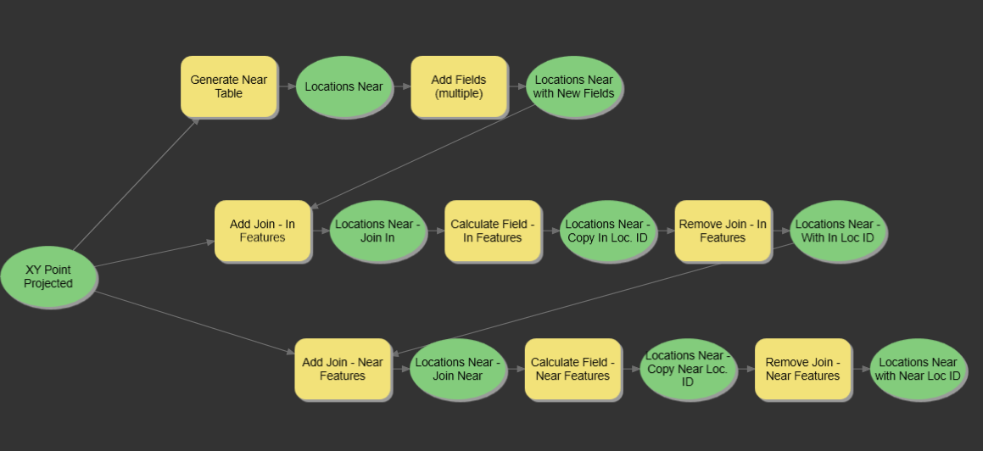
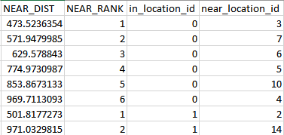
GIS Analysis
Calculates distances for each location node to other location nodes within 1000 ft
Used in Louvain community detection and Page Rank analysis
Model built in ArcGIS Pro ModelBuilder, which executes a series of tools to calculate distances between each location which can then be written to a CSV to load into Neo4J.

Slide 6
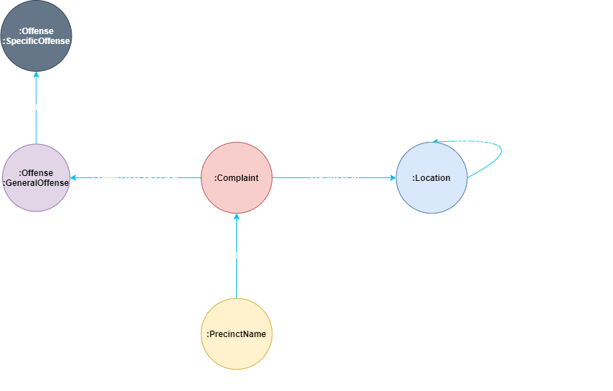
Data Model
Details about when the complaint occurred
Where the complaint occurred (spatial)
Provide a general category and a more specific category of offense
Relationship between nearby locations calculated by distance
Precinct that reported the complaint

Slide 7
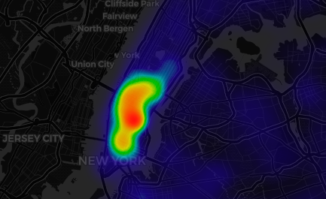
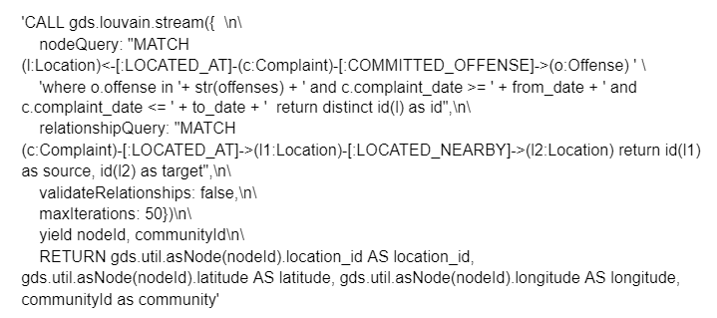
Hotspot Cluster Analysis - Louvain Communities
Communities of similar locations - using the complaints, offenses and nearby locations
Average coordinates of locations in each community determine the point of the cluster
The sum of the complaints for all location in each community make up the cluster intensity
User can change the date range and select one or multiple offenses to investigate

Slide 8
DEMO

Slide 9
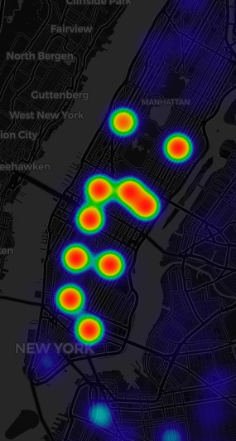
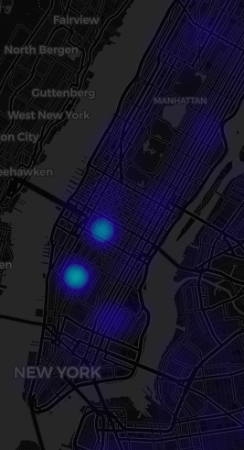
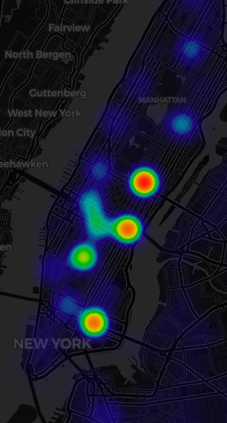
Hotspot Cluster Analysis - Grand Larceny
44/1/2019 - 4/30/2019
44/1/2020 - 4/30/2020
43/1/2021 - 3/30/2021

Slide 10
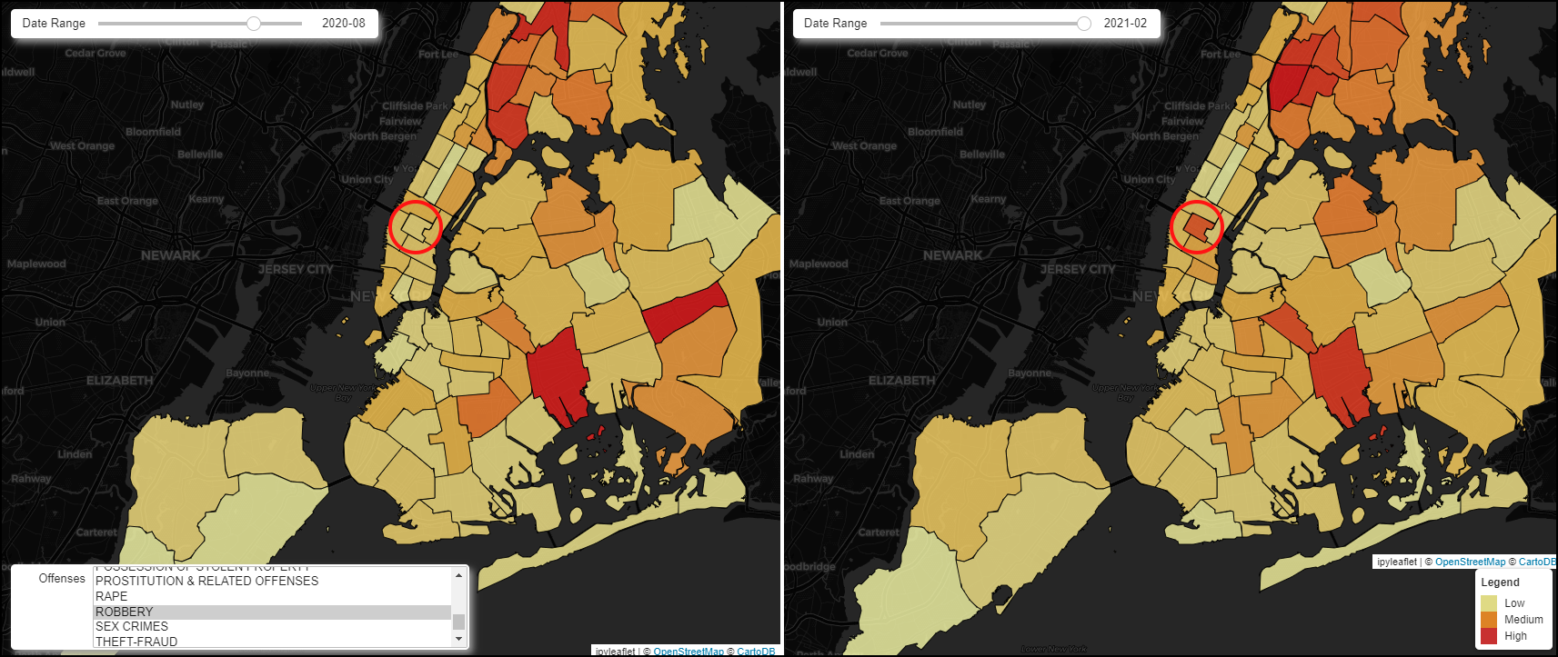
Comparison of Precinct Complaints by Dates
View of how precincts are performing in terms of the number of complaints by comparing different time periods
Easier to detect changes with a side by side comparison

Slide 11
DEMO

Slide 12
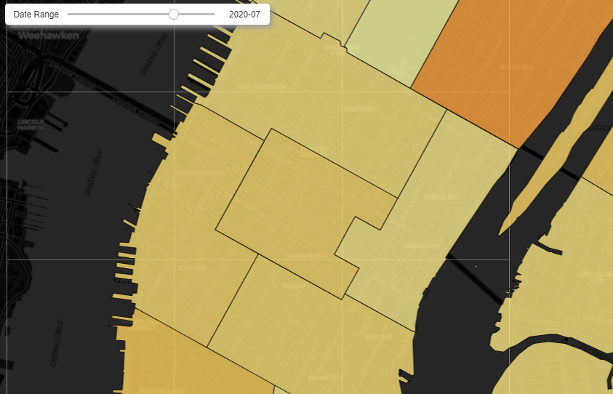
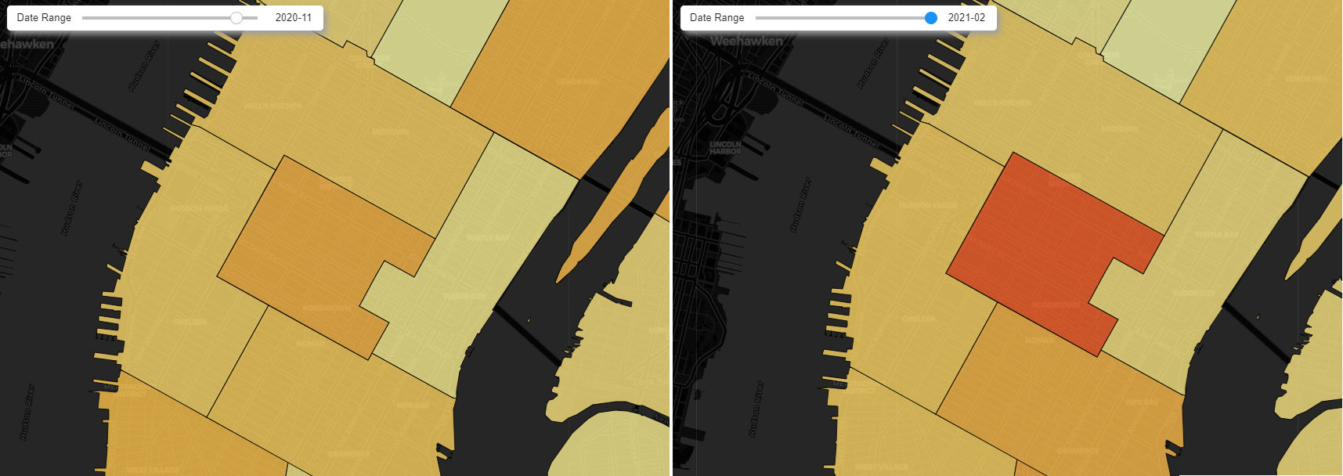
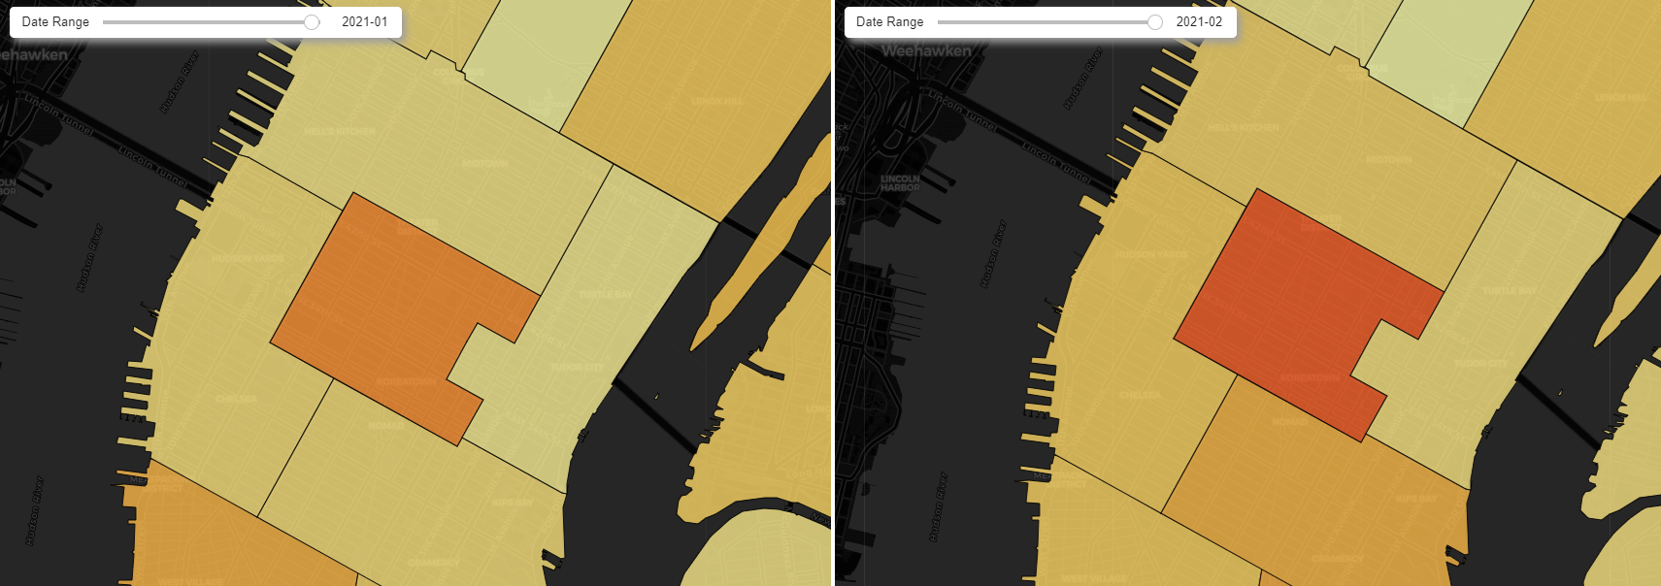
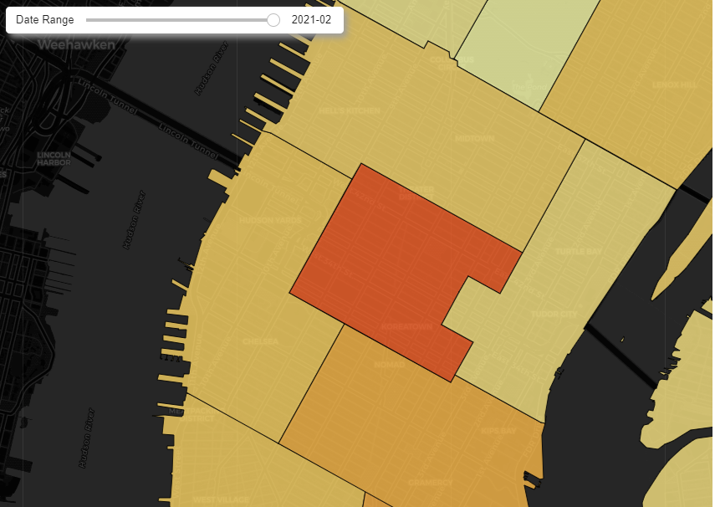
Comparison of Precinct Complaints by Dates
Precinct 14 covers the area between 34th Street and 42nd Street which is a major tourist hotspot.
Gradual increase in complaints from July 2020 to February 2021
Tool helps identify change in complaint levels over time at a high level
Robberies - Precinct 14
July 2020
Low
November 2020
Medium
January 2021
Medium High
February 2021
High

Slide 13
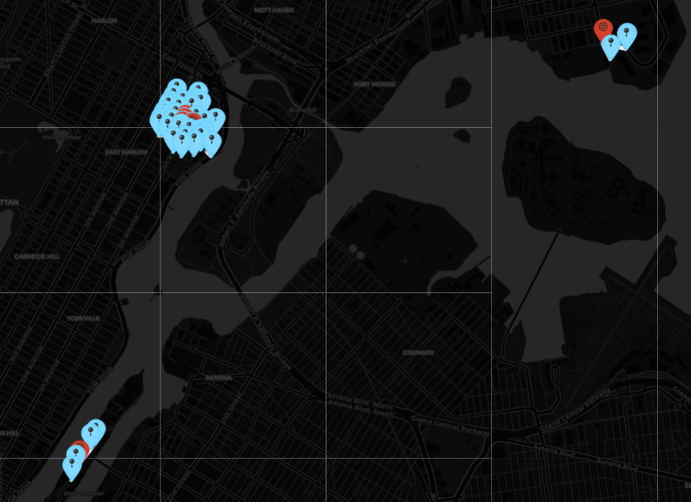
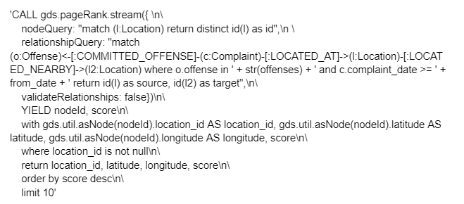
Top 10 Locations of Offenses using Page Rank
Page Rank centrality algorithm finds the top ranking locations where offenses are occurring
Takes into account nearby locations and the complaints to calculate the top locations.
Users can select one or multiple offenses and change the number of days back to search for complaints
Useful to know where to allocate resources such as patrols or technology such as security cameras

Slide 14
DEMO

Slide 15
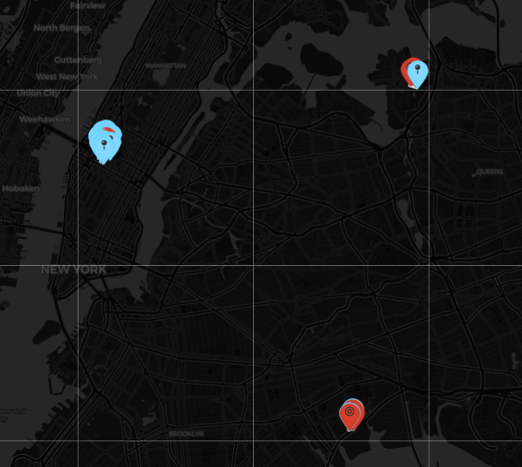
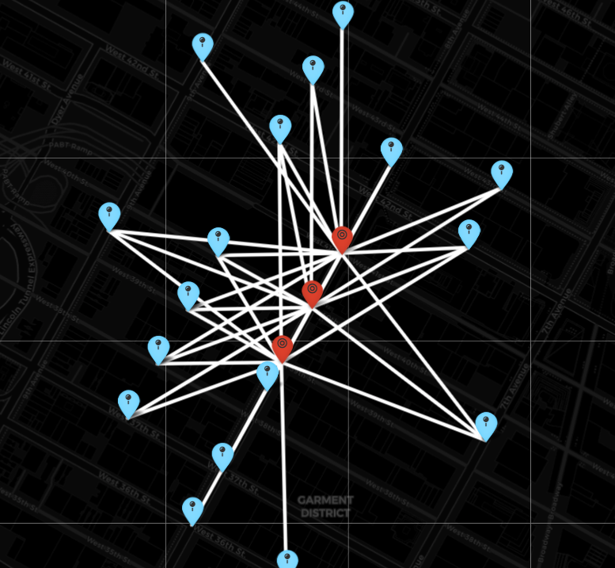
Top 10 Locations of Offenses using Page Rank
Uses the Page Rank centrality algorithm to find the top ranking locations to where offenses are occurring
Takes into account nearby locations and the complaints to calculate the top locations.
Useful to know where to allocate resources such as patrols or technology such as security cameras
Page Rank chose these locations given how central they are to the nearby locations where the same offenses occurred.

Slide 16
Conclusion
Maps help tell a story about when and where patterns of complaints are emerging
Complaints can be compared at different levels of detail - Precinct or Coordinates
Each maps serves a different purpose
Locating communities of similar offenses to find clusters
Change in complaint levels by precinct at different time periods
Finding central locations of offenses

